Slide 1


Team & Project Management: Methods & Tools

Slide 2
Team + Building

Slide 3


Starting a Group Project
Working in ICT
We’ve already assembled our team, warmed up to them a bit (hopefully) and ready to start getting ready for assessment work!
We want to breakdown the assessment into tasks
Assign responsibilities and team roles
Apportion tasks to members as individual responsibilities
Determine a team name!

Slide 4
Meeting & Setting Team Responsibilities
Working in ICT
You may hold a team meeting to discuss and determine the following:
Outline what each person wants to get out of project
Confirm the team norms by discussing how much time people can commit & tools they would like to use to communicate with
Set core ground rules as a minimum expectations of team members
Set loose team roles, including leader (you may not see one as necessary, but can help)

Slide 5
MOST Important Discussion
Working in ICT
You are required to give your team … A TEAM NAME. This is a well-known industry fact for developers as the very first step!
Some examples of ACTUAL developer team names in Australian organisations:
Team Kraken
Team Foobar
Team return to_sleep
Team frAgile
…even one name was called “Scrumbledore’s Army”

Slide 6
Issues within the Team

Slide 7
Question: What issues have you encountered before when working as part of
student or organisation teams?

Slide 8

Don’t Be the Kyle!
Working in ICT
https://youtu.be/U0zOqSRzR-s [4mins] (image attributable to Domics Animations)

Slide 9
Team Work Problems
Working in ICT
Project work, and particularly tertiary team work, is synonymous with team member issues, friction and undesirable complications
Each member will vary in terms of availabilities - family commitments, part-time work, illness and so on.
To counter this we must set clear expectations of each of us, use tools to help organise and arrange consistent meetings and importantly, be a team player.

Slide 10
Work Collaboratively : Assessed Individually
Working in ICT
The team’s will need to work together to achieve the team goal and assessment expectations
This is NOT an excuse to make one member pull the weight of the team!
The team responsibility is apportioned individually. No member can hide behind another member and shirk their responsibilities to the team & assessment

Slide 11
Other Team Issues to Consider
Working in ICT
Disproportionate team work between members may be the most consistent issue in teams, but other problems can occur which require careful action to manage:
Issue: Disputes and conflict amongst members
Solution: Difference of opinion is often healthy, but if it results in aggressive conflict, it must be managed. Try to remove the actors from initial conflict, approach at a later stage, and if unresolved, approach us to mediate
Issue: Lack clear direction or decisive action
Solution: Ensure responsibilities, roles AND, a team leader, are determined and appointed. The team leader needs to step up and focus direction if team is lacking

Slide 12
Other Team Issues to Consider
Working in ICT
Issue: Working in silos causing work overlap
Solution: Ensure there is a consensus on collaborative tools and then ”put your faith” solely in those tools. Ensure you set consistent meetings to refine team roles, which can change and adapt as the project changes and evolves.
Issue: Member having issue with responsibilities to required competence
Solution: Try to arrange a meeting and go over individual skills and strengths. Try to find areas of confidence for the team member and assign responsibilities that would best suit. If unable, try to apportion tasks to two people to manage together to allow for joint-learning.

Slide 13
Don’t leave it to others
Working in ICT
“Only when the tide goes out do you discover who's been swimming naked.
Warren Buffett

Slide 14
Project Management: Methodologies

Slide 15
“Project Management Methodology”
Working in ICT
What does this term even mean?
The strict textbook definition describes them as “systems of practices, techniques, procedures, and rules used by those who work in a discipline”
In simple – the methodologies are different processes, ONE of which we can choose at the start of a project, that:
provides guidance to the team on the project build; and
outline the steps to take to complete tasks needed by the overall deadline

Slide 16
Method 1: Agile
Working in ICT
Best suited for:
Projects that require flexibility and have a level of complexity or uncertainty. For instance, a product or service that hasn’t been built by the team.
Structure of Project Management:
Projects are iterative and incremental – often broken up into discrete tasks and completed in “Agile Sprints” (1-4 weeks long)
No. of sprints needed are determined at the start of the project
Heavy focus on collaboration, especially between cross-functional teams & their customers
Generally used by large, comprehensive teams and arguably, Scrum & Kanban are subsets of Agile Methodology

Slide 17
Method 2: Scrum
Working in ICT
Best suited for:
Projects that consists of teams of less than seven people who need a flexible approach to delivering a product or service. Generally, requires a bit of setup and often a level of management overseeing the project.
Structure of Project Management:
Set scrum team roles: Product owner, Scrum manager/master & development team
Scrum events: Sprint (iterative time boxes to accomplish goal/task), Sprint Planning, Daily Scrum (15 minute meeting at start of day), Sprint reviews & sprint ”retrospectives”
Scrum artifacts: Product backlog (where you list all requirements needed for viable product & listed in priority order) & Sprint backlog (tasks to be completed during next sprint)

Slide 18
Method 3: Kanban
Working in ICT
Best suited for:
Like Scrum, Kanban is fitting for projects with smaller teams, who need a flexible but productive approach to delivering a product or service. Importantly, Kanban emphasises visualisation of tasks!
Structure of Project Management:
6 General Practices: Visualisation, Limiting WIP, Flow Management, Explicit Policies, Feedback Loops & Collaboration
Kanban Board: Visualises the development process, including digital boards.
Kanban Cards: Each card depicts a work item/task in the work process. Used to communicate progress with your team / client & represents information such as status, cycle time & deadlines
Kanban “Swimlanes”: Kanban visualises workflow horizontally & distinguishes items/tasks by categorising them & their progress

Slide 19
Other Popular Methods
Working in ICT
There are other methodologies used to coordinate and organise project management, including:
Waterfall (falling popularity)
Lean
Six Sigma
PMI / PMBOK
To review these or see more detail: https://zenkit.com/en/blog/7-popular-project-management-methodologies-and-what-theyre-best-suited-for/

Slide 20
Agile v Scrum
Working in ICT
Agile is an organisation-level commitment / Scrum is
Agile is set of values and principles adopted by an organisation & often requires significant cultural change. Agile thinking allowed for scrum to develop!
Scrum is a framework for GETTING WORK DONE and shipping an end-product whilst meeting deadlines!
At the core of Scrum are Sprints
Sprints are broken up into four core “ceremonies” with “artifacts” to collect at each stage

Slide 21
Sprint Cycle & “Ceremonies”
Working in ICT

Slide 22
Project Management Tools:
Communication Plan

Slide 23
Communications Plan
Working in ICT
PURPOSE: A project management communication plan identifies how important information will be communicated to stakeholders throughout the project.
ADDITIONALLY: Determines who will be receiving the communication, how those people will receive it, when they’ll receive it, and how often they should expect to receive that information.
WHY: Communication plans matter in your projects because effective communication, both internal and external, is critical to project success. Planning these makes them effective!
Having a project communication plan outlining stakeholders, as well as when and how to reach them, is essential!

Slide 24
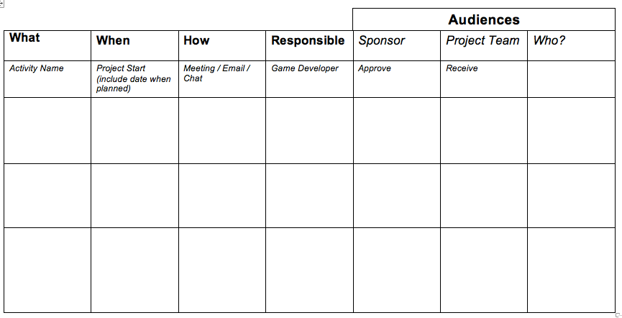
Assessment 2: Older Template
Working in ICT

Slide 25
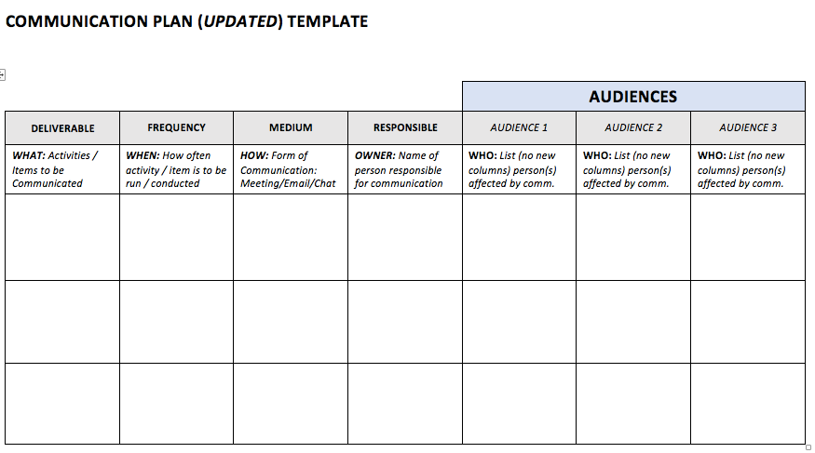
Assessment 2: Updated Plan
Working in ICT

Slide 26
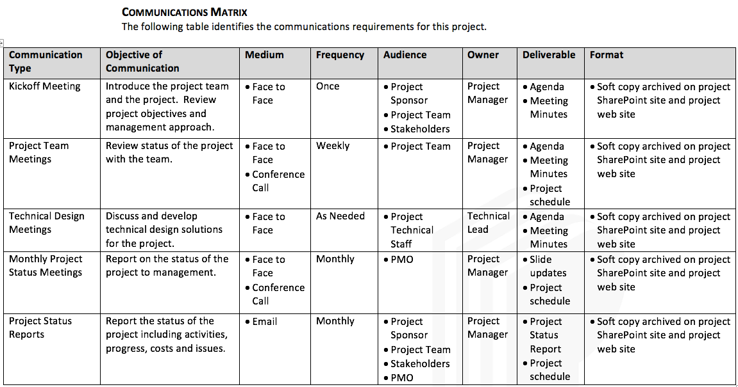
Assessment 2: Example Matrix
Working in ICT

Slide 27
Comm. Plan Pointers
Working in ICT
KEY: Each group is welcome to adapt and change their communication plan to a template / format that works for them.
Only restriction is the chosen communication plan must outline at bare minimum a set of planned communications that details their frequency, who is responsible, the form & the audience!
Other useful examples of template matrixes:
https://blog.hubspot.com/marketing/communications-plan
https://www.lucidchart.com/blog/project-management-communication-plan

Slide 28
Project Management Tools:
Task Manager

Slide 29
Main Tool: Trello
Working in ICT
We will use Trello to assist managing our project through from goal/task inception all the way to completion:
Trello is a project management tool designed to help break projects into tasks and allow for horizontal workflow and progression
Trello is one of many pieces of software owned and run by the Australian-run Atlassian. One of the largest Australian tech companies.
Trello is broken up into three core parts: Boards, Lists & Cards (example: https://trello.com/b/djWbWhAf/video-status)

Slide 30
Trello Setup
Working in ICT
Plan of Attack for Remainder of Class (if time):
Setup of Trello Account & Organising Home Workspaces (Goal: everyone register & on home page)
Familiarising ourselves with Home Page (Goal: Understand workspaces, members, boards & profile)
Understanding the Boards page & core items to track (Goal: Visibility settings, Active Members, Workspace area)
Setting up Board, Lists & Cards & how to bring in team members (Goal: Basic setup with team/client inside board workspace, card setup including members, labels, checklists, due dates & cover)
Advanced Project Management using Templates (Goal: Setup of Kanban Template Board & how it works)

Slide 31
Trello Troubleshooting
Working in ICT
If you get stuck whilst using Trello or want to expand knowledge:
Ask Us: Ask Alex for assistance!
LinkedIn-Learning: https://www.linkedin.com/learning-login/share?account=57076585&forceAccount=false&redirect=https%3A%2F%2Fwww.linkedin.com%2Flearning%2Ftrello-essential-training%3Ftrk%3Dshare_ent_url%26shareId%3D7lY4jtJOQk%252Bhmuk2gs6PWQ%253D%253D
Trello Help: Common issues encountered and support help
Online Guides: Plenty of guides, including YouTube, that show different approaches to Trello
Worst case - resort to watching Silicon Valley for tips: https://youtu.be/ercuK-MCZVg

Slide 32
Project Management Tools:
Other Tools

Slide 33
Tools you will need
Working in ICT
Live communication platform for team
Communication plan (done!)
Scheduling tool (done!)
A way to share calendar events
A way to track and assign responsibilities
GitHub Repo
Images and Video hub
A location to collaborate on documents and other files and stores references to important data eg. Location of GitHub repo Contact Details Shared Calendar Share Important files
TIP: Keep you share cloud storage organised and well named!

Slide 34



Working in ICT

Slide 35


Working in ICT

Slide 36


Working in ICT

Slide 37

Working in ICT

Slide 38
Breakout: Confirm & document which tools you will use – workspace, task manager, calendar, document system

